Slide 1
Analysis on Unicorn Companies
This project focused on Unicorn Companies, with a valuation over $1 billion. This project involves analyzing the dataset to answer questions. The goal of the project is to come up with at least four data-driven recommendations to help Unicorn Companies create good business models and make decisions that prioritize companies with high growth potential, diversify their investment portfolio and prioritize companies with experienced leadership teams.

Slide 2
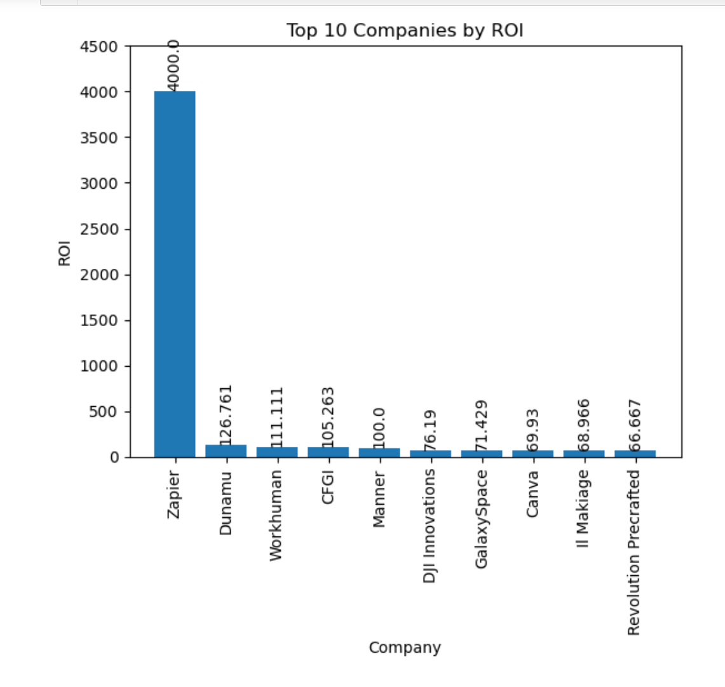
Return on Investment
Observation
The chart shows top 10 unicorn companies with the highest return on investment (ROI). These companies have been most successful in generating returns for their investors.

Slide 3
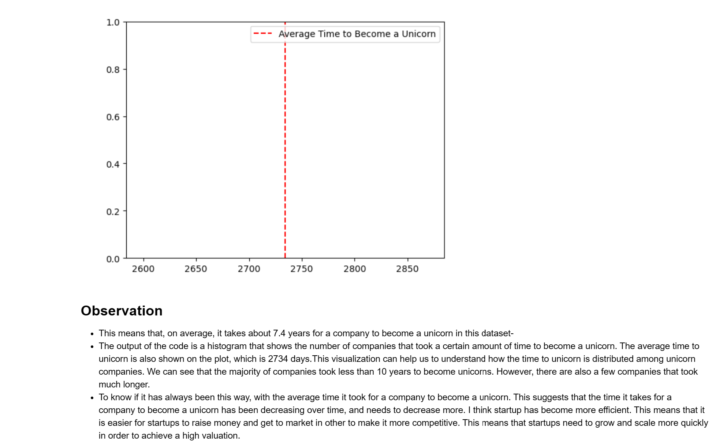
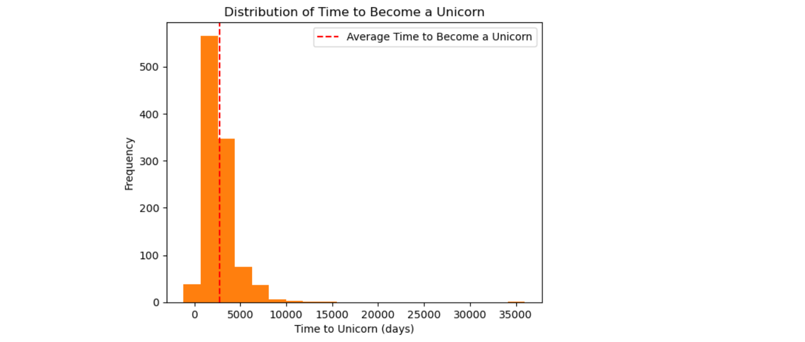
How long does it usually take for a company to become a unicorn? -Has it always been this way?
Observation
The output of the code is a histogram that shows the number of companies that took a certain amount of time to become a unicorn. The average time to unicorn is also shown on the plot, which is 2734 days. This visualization can help us to understand how the time to unicorn is distributed among unicorn companies. We can see that the majority of companies took less than 10 years to become unicorns. However, there are also a few companies that took much longer.
To know if it has always been this way, with the average time it took for a company to become a unicorn. This suggests that the time it takes for a company to become a unicorn has been decreasing over time, and needs to decrease more. I think startup has become more efficient. This means that it is easier for startups to raise money and get to market in other to make it more competitive. This means that startups need to grow and scale more quickly in order to achieve a high valuation.

Slide 4
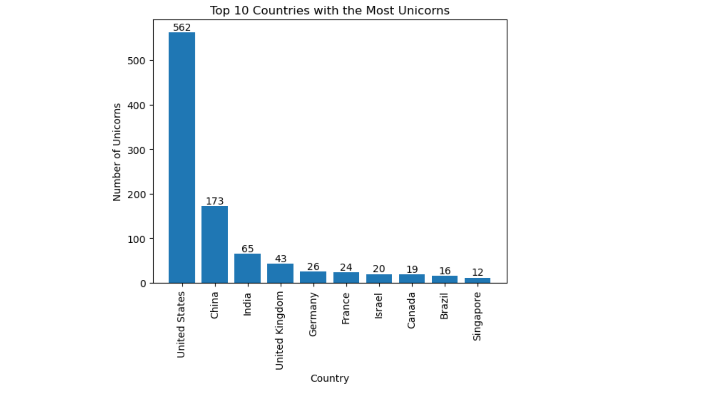
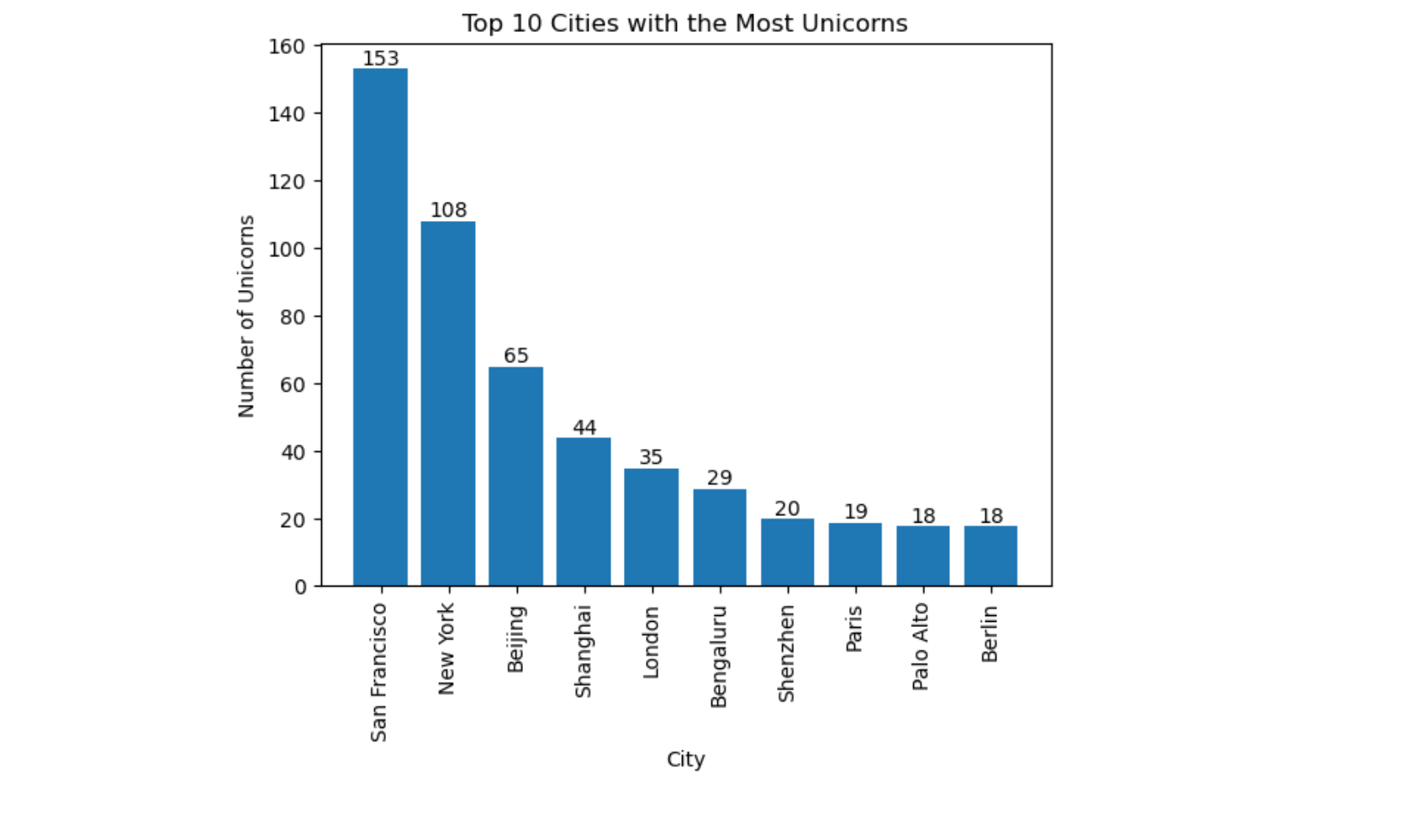
Which countries have the most unicorns? -Are there any cities that appear to be industry hubs?
Observation
We can see the top 10 countries with the most unicorns, is united state, followed by China, Also we can see that San Francisco and New York City have the most unicorns, followed by Beijing and Shanghai. This suggests that these cities are major hubs for technology and innovation. We can also see that some cities appear to be industry hubs within a country. For example, Paris is a major hub for the technology industry in France. Similarly, Berlin is a major hub for the technology industry in Germany.

Slide 5
Overall Recommendations
I recommend that:
To start adopting more use of data to make decisions. Data can be a powerful tool for making better decisions. Collect data on your target market, your competitors, and the industry as a whole. Use this data to identify opportunities, assess risks, and make informed decisions about your business.
To put having good leaders into consideration, having a good leadership team is essential for the success of any company, they should prioritize companies led by leadership teams who have a track record of success in their fields.
To regularly assess business models; Continuously. Refine the company's business model to ensure it aligns with changing market conditions and emerging opportunities. Leverage data analysis to identify areas, for improvement or potential modifications that can enhance growth prospects.
To build an investment portfolio by considering opportunities across industries and geographies. This will help mitigate risks associated with concentrating investments in a sector.
To regularly Update business models based on real time data insights to ensure alignment with changing market dynamics.
To Continuously monitor performance indicators (KPIs) related to revenue growth, customer acquisition, retention rates, profitability, etc. using these metrics as benchmarks, for evaluating business performance.

